Slide 1
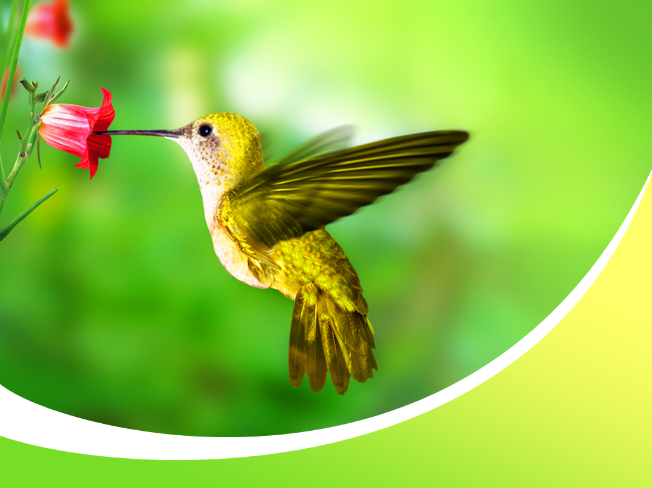

Bird Study Merit Badge
Troop 344 and 9344
Pemberville, OH

Slide 2

Bird Study Merit Badge Requirements
Explain the need for bird study and why birds are useful indicators of the quality of the environment. Describe how birds are part of the ecosystem.
Show that you are familiar with the terms used to describe birds by doing the following:
  Sketch or trace a perched bird and then label 15 different parts of the bird.
  Sketch or trace an extended wing and label six types of wing feathers.
Demonstrate that you know how to properly use and care for binoculars, a spotting scope, or a monocular.
  Explain what the specification numbers mean on binoculars, a spotting scope, or a monocular.
  Show how to adjust the eyepiece and how to focus for proper viewing.
  Show how to properly care for and clean the lenses.
  Describe when and where each type of viewing device would be most effective.

Slide 3

Bird Study Merit Badge Requirements
Demonstrate that you know how to use a bird field guide. Show your counselor that you are able to understand a range map by locating in the book and pointing out the wintering range, the breeding range, and/or the year-round range of one species of each of the following types of birds:
  Seabird
  Plover
  Falcon or hawk
  Warbler or vireo
  Heron or egret
  Sparrow

Slide 4
Bird Study Merit Badge Requirements
Observe and be able to identify at least 20 species of wild birds. Prepare a field notebook, making a separate entry for each species, and record the following information from your field observations and other references.
  Note the date and time.
  Note the location and habitat.
  Describe the bird's main feeding habitat and list two types of food that the bird is likely to eat.
  Note whether the bird is a migrant or a summer, winter, or year-round resident of your area.

Slide 5
Bird Study Merit Badge Requirements
Describe to your counselor how certain orders of birds are uniquely adapted to a specific habitat. In your description, include characteristics such as the size and shape of the following:
  Beak
  Body
  Leg and foot
  Feathers/plumage
Explain the function of a bird's song. Be able to identify five of the 20 species in your field notebook by song or call alone. Explain the difference between songs and calls. For each of these five species, enter a description of the song or call, and note the behavior of the bird making the sound. Note why you think the bird was making the call or song that you heard.

Slide 6
Bird Study Merit Badge Requirements
Do ONE of the following:
  Go on a field trip with a local club or with others who are knowledgeable about birds in your area.
    Keep a list or fill out a checklist of all the birds your group observed during the field trip.
    Tell your counselor which birds your group saw and why some species were common and some were present in small numbers.
    Tell your counselor what makes the area you visited good for finding birds.

Slide 7

Bird Study Merit Badge Requirements
Do ONE of the following:
  By using a public library, the Internet, or contacting the National Audubon Society, find the name and location of the Christmas Bird Count nearest your home and obtain the results of a recent count.
    Explain what kinds of information are collected during the annual event.
    Tell your counselor which species are most common, and explain why these birds are abundant.
    Tell your counselor which species are uncommon, and explain why these were present in small numbers. If the number of birds of these species is decreasing, explain why, and what, if anything, could be done to reverse their decline.

Slide 8
Bird Study Merit Badge Requirements
Do ONE of the following:
  Participate in a bird banding program with an approved federal or state agency, university researcher, bird observatory, or certified private individual.
    Explain who is able to band birds and why.
    Explain why birds get banded.
    Explain what kinds of birds get banded.
    Tell how the birds were captured, the number of bird species recorded during your visit, and your role in the program.

Slide 9
Bird Study Merit Badge Requirements
Do ONE of the following. For the option you choose, describe what birds you hope to attract, and why.
  Build a bird feeder and put it in an appropriate place in your yard or another location.
  Build a birdbath and put it in an appropriate place.
  Build a backyard sanctuary for birds by planting trees and shrubs for food and cover.
Do the following:
  Explain the differences between extinct, endangered, and threatened.
  Identify a bird species that is on the endangered or threatened list. Explain what caused their decline. Discuss with your counselor what can be done to reverse this trend and what can be done to help remove the species from the endangered or threatened list.

Slide 10
Bird Study Merit Badge Requirements
Identify a nonnative bird (introduced to North America from a foreign country since 1800). Describe how nonnative birds may become damaging to the ecosystem.
Identify three career opportunities connected to the study of birds. Pick one and find out the education, training, and experience required for this profession. Discuss with your counselor if this profession might interest you.

Slide 11
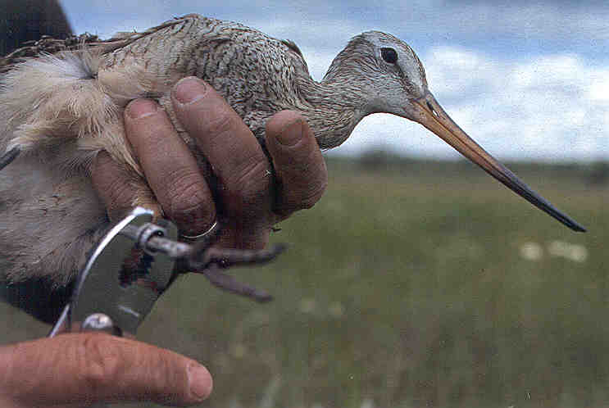
Requirement 1
Explain the need for bird study and why birds are useful indicators of the quality of the environment. Describe how birds are part of the ecosystem.

Slide 12
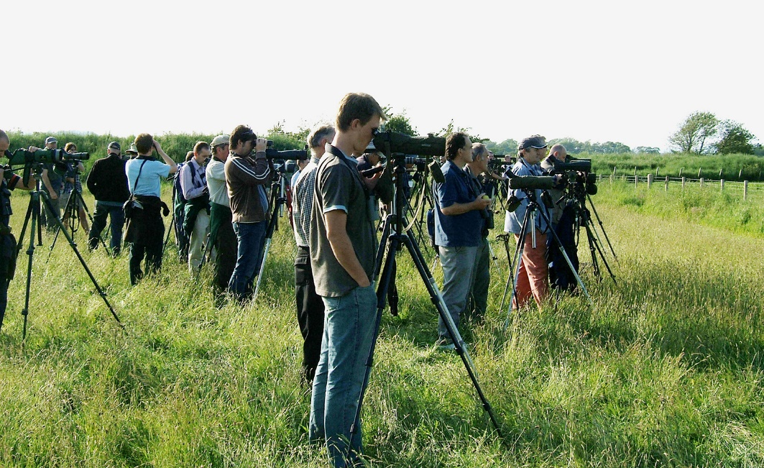
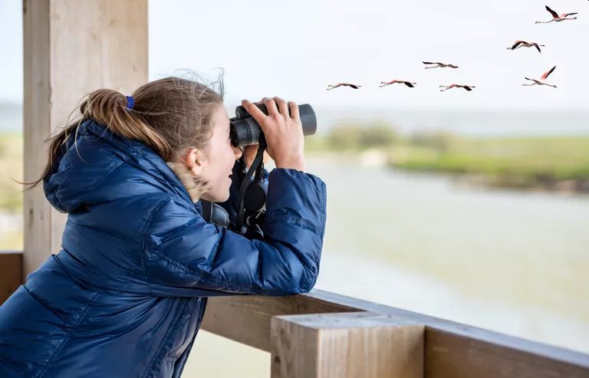
Why Study Birds
Bird watching and related eco-tourism is a major economic force in many parts of the country.
On a less quantitative level, birds provide humans with pleasure, joy, and spiritual inspiration merely by their presence.

Slide 13
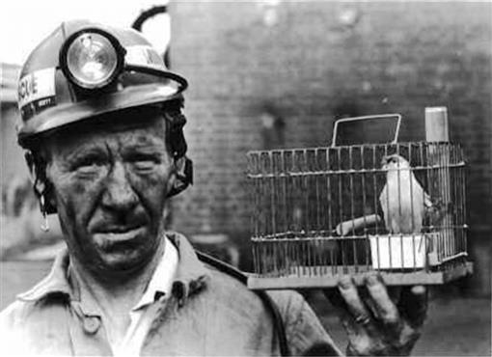
Birds and the Environment
Birds are also excellent indicators of environmental health.
  Before “the canary in the coal mine” was a cliché, underground workers really did take canaries with them to provide early detection against carbon monoxide and other gases.

Slide 14
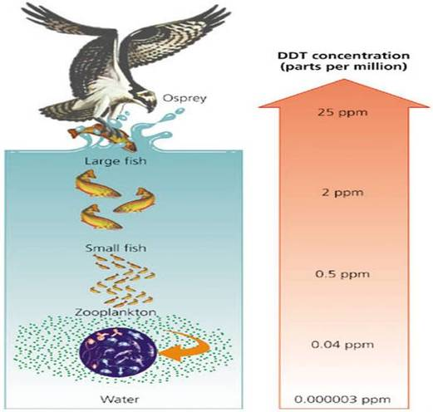
Birds and the Environment
In the natural world, because they are relatively abundant, easily observed, and have a rapid metabolism and high position on the food chain, birds can provide clues to otherwise difficult to detect processes.
Declines in Peregrine Falcons and Bald Eagles provided important information about the dangers and spread of DDT and heavy metals.
Today, changes in bird populations can tell us a great deal about the impacts of climate change, drought, weather, and habitat change in the United States and around the world.

Slide 15
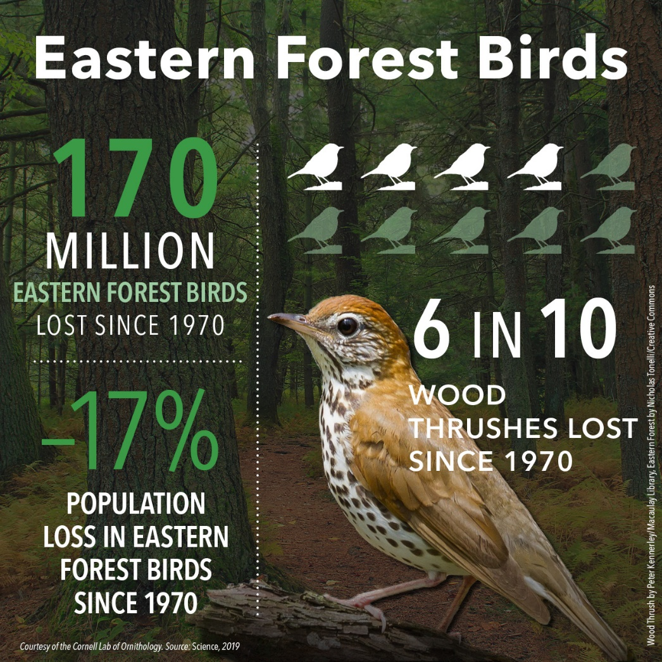
Birds and the Environment
Perhaps the most important reason to study birds is to further our understanding of the ecosystems that support all life on earth, including humans.
To continue to live sustainably and have a healthy planet, we must understand how the natural systems on which we depend function.
Birds are a critical element to nearly every ecosystem on earth, and their fate is intertwined with ours.

Slide 16
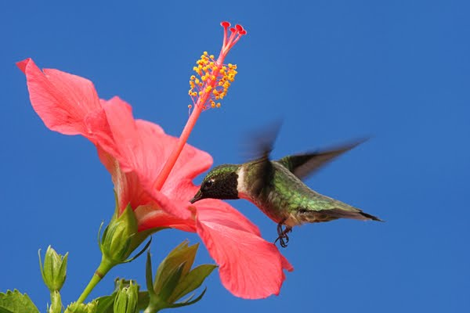
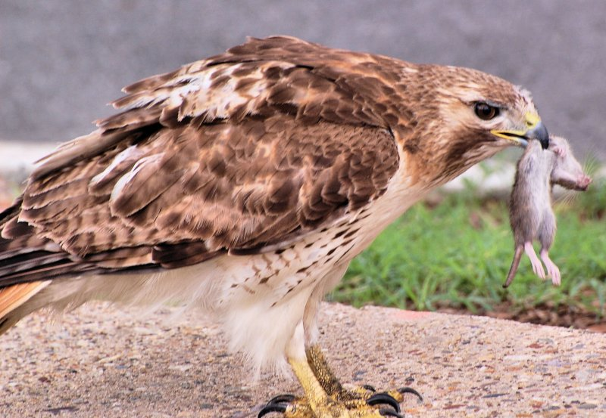
Birds as Part of the Ecosystem
Birds provide many direct and indirect contributions to the environment (often called “Ecosystem Services”).
Many ecologically important plants require pollination by birds, especially hummingbirds, in order to successfully reproduce.
Many species of conifers are spread largely by birds such as Clark’s Nutcrackers and Pinyon Jays, and fruit-eating birds likewise aid the germination and spread of hundreds of species of plants and trees.
Hawks and owls are great consumers of pests such as rodents, while flycatchers and their allies consume many tons of insects each year.

Slide 17
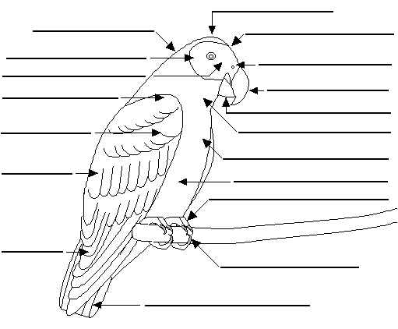
Requirement 2
Show that you are familiar with the terms used to describe birds by doing the following:
  Sketch or trace a perched bird and then label 15 different parts of the bird.
  Sketch or trace an extended wing and label six types of wing feathers.

Slide 18
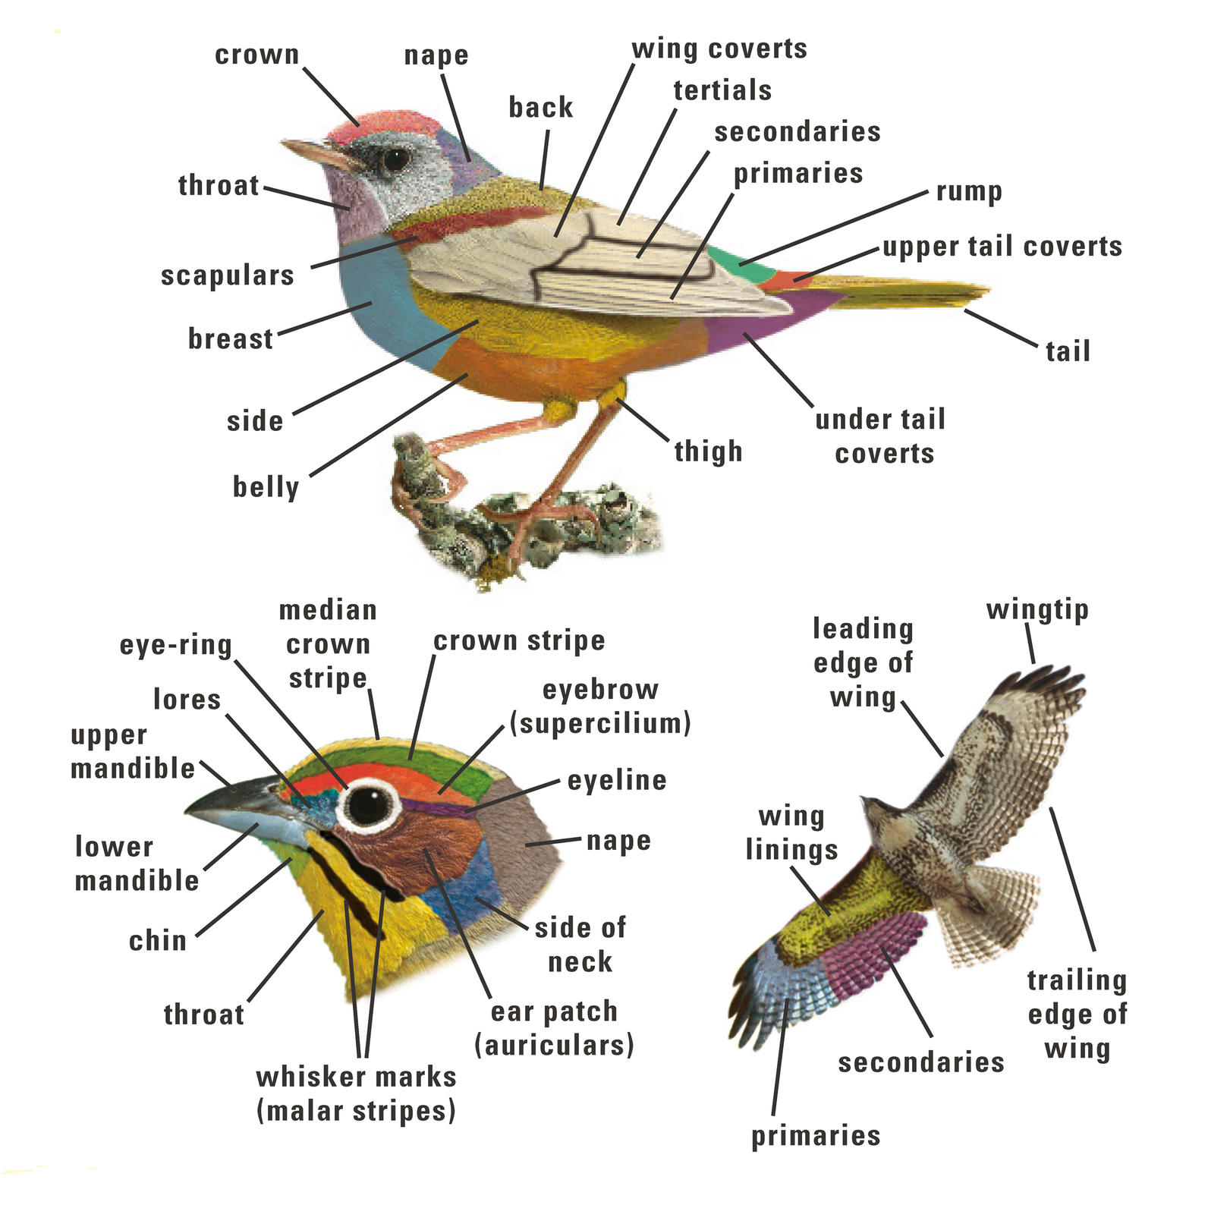
Parts of a Bird

Slide 19
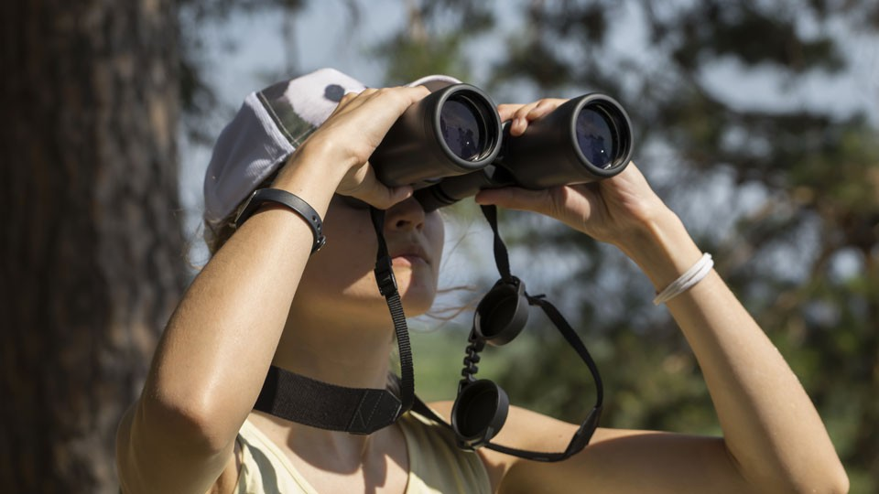
Requirement 3
Demonstrate that you know how to properly use and care for binoculars, a spotting scope, or a monocular.
  Explain what the specification numbers mean on binoculars, a spotting scope, or a monocular.
  Show how to adjust the eyepiece and how to focus for proper viewing.
  Show how to properly care for and clean the lenses.
  Describe when and where each type of viewing device would be most effective.

Slide 20
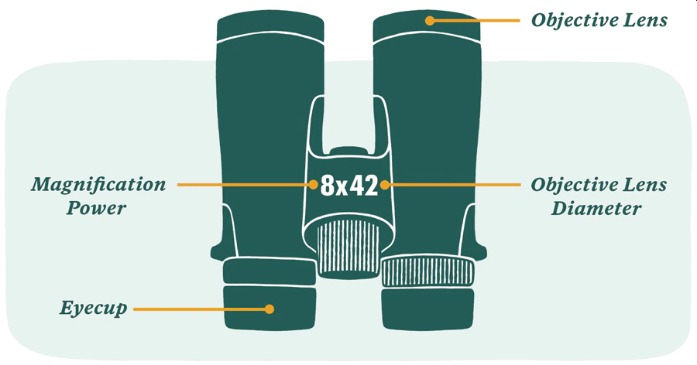
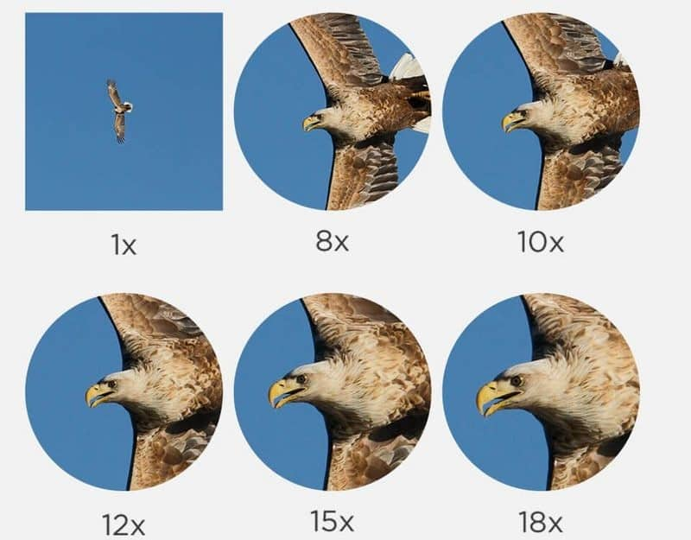
3a What Do the Numbers Mean?
Every pair of binoculars has a set of numbered specifications on it, like 7X35, 8X40, or 10X50.
The first number refers to the magnification—how large the binoculars make an object appear when you look through them.
  The larger the number, the greater the magnification. But as the magnification increases, the field of view—the area you see when you actually look through the binoculars—gets smaller.
  A small field of view makes it harder to find a bird in the glasses. Higher magnification also increases the minimum focusing distance—how close to you the binoculars can be focused.
  That means that while a pair of 10-power binoculars make a bird look larger than a 7-power pair will, you might not be able to focus on it if the bird is fairly close to you, say, 15 feet away—a common distance when watching songbirds.

Slide 21
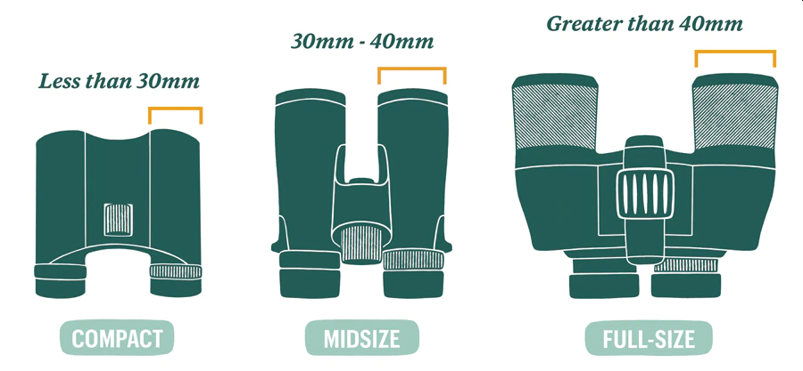
3a What Do the Numbers Mean?
Every pair of binoculars has a set of numbered specifications on it, like 7X35, 8X40, or 10X50.
The second number of the specification shows, in millimeters, the width of the large objective lenses at the front of the binoculars.
  The larger the number (and the lens), the more light the binoculars take in and the brighter the image you see.
  Most birding experts recommend 7X35 binoculars as the best choice for beginners, combining reasonable magnification with sufficient field of view.
  Avoid compact binoculars with an objective lens size of less than 35mm—the field of view is so small it can be frustrating to find the bird, and the image tends to be dark and murky.
  Do not use binoculars greater than 40mm; they are too heavy and bulky for birding.

Slide 22
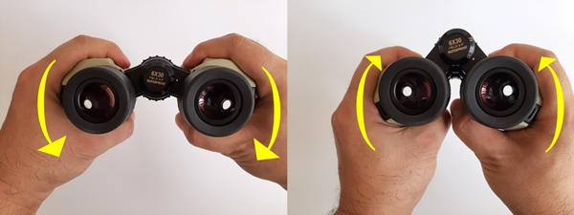
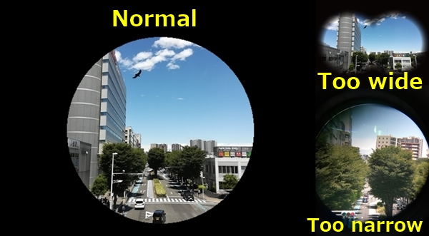
3b How to Use Binoculars
Adjust the distance between the binocular barrels.
Grasp the barrels with your hands and press them inward toward each other to decrease the distance between them.
Conversely, pull them outward away from each other to increase this distance.
Keep adjusting your barrel distance until your view is a perfect circle.
If you see black edges in your field of vision, the barrels are too far apart—press them downward.
Each pair of binoculars is made up of two barrels, which contain both contain an eyepiece with a prism inside and an objective lens at the end.

Slide 23
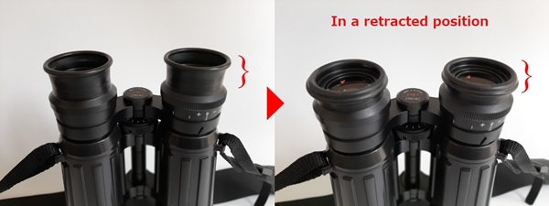
3b How to Use Binoculars
Adjusting the eyecups
To have an ideal eye point, you’ll need to adjust the eyecups. There are two types of eyecups; “Fold-up/down” and “Twist-up/down” eyecups.
  The most popular these days are the twist-up/down type.
Fold up/down eyecups
  Fold-up/down rubber eyecups are not used in newer binoculars.
  For eyeglass wearers, fold the eyecups down to a retracted position (see photo).
  This is because you need more distance between the ocular lens and your eye with your glasses in-between.
  For non-eyeglass wearers, keep the eyecups extended to get a full field of view.

Slide 24
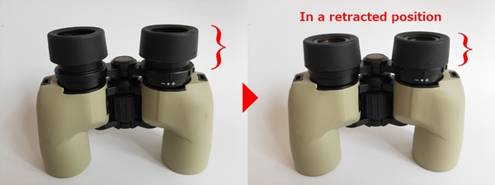
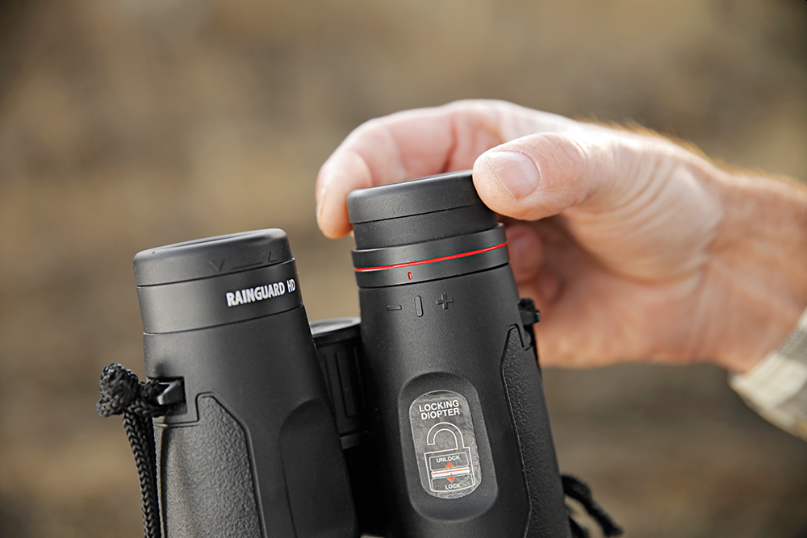
3b How to Use Binoculars
Twist-up/down eyecups
  Binoculars with twist-up/down eyecups are becoming more popular.
  They have two major advantages: incremental height adjustment and durability.
  Using twist-up/down eyecups is straightforward.
  Turning the eyecup counterclockwise extends its position.
  Turning clockwise retracts it.
  The height of the eyecups can be set to work perfectly for any user.
It’s important to find the eyepoint so that you can get the entire field of view without blackout.
Eyecups also prevent your eyelashes from touching the ocular lenses.

Slide 25
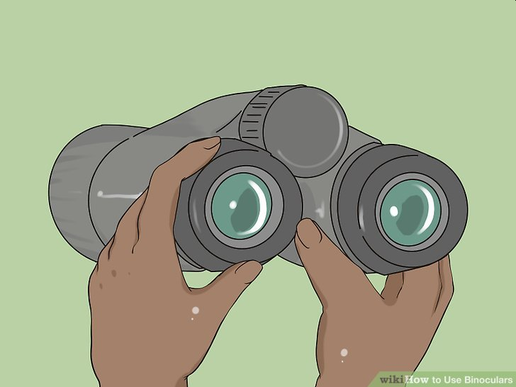
3b How to Use Binoculars
Place your eyecups in the middle position for the most flexibility.
If you're going to be traveling somewhere with a variety of views and conditions, the middle eyecup position is ideal.
Press or pull them until they sit in the middle of fully extended and fully retracted.
It will give you a nice field of view, block out a good deal of peripheral light, and protect the ocular lens from dirt and dust.

Slide 26
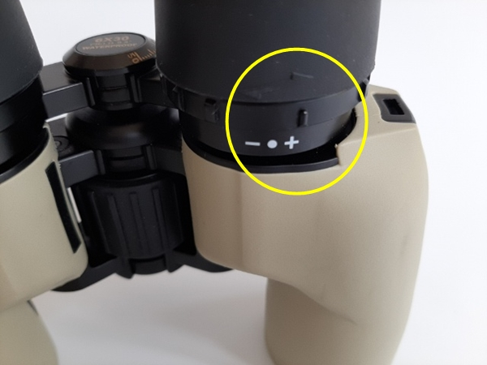
3b How to Use Binoculars
Locate the diopter adjustment on your binoculars.
The diopter adjustment is to compensate if you have a difference in the acuity of your eyes.
Without this setup, one of your eyes may see objects in focus while the other does not.
There are two steps to adjusting the diopter: focusing your left eye, then focusing your right eye.

Slide 27
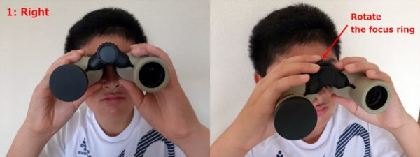
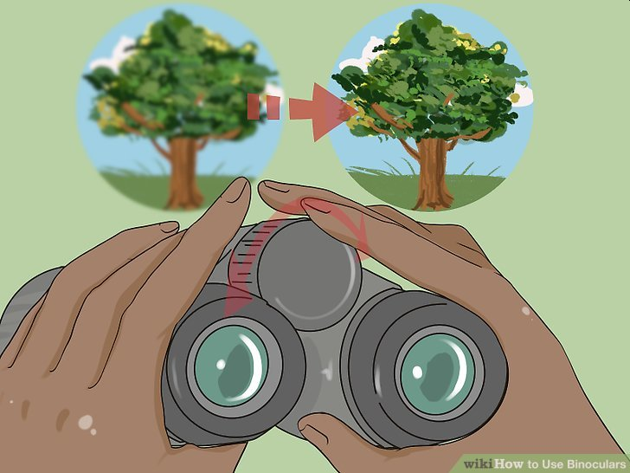
3b How to Use Binoculars
Focus your left eye using the focusing knob.
  First, put the cap on the right objective lens so that you can only see an image with your left eye.
  Now, turn the center focus wheel until you can see the object in as much detail as possible.

Slide 28
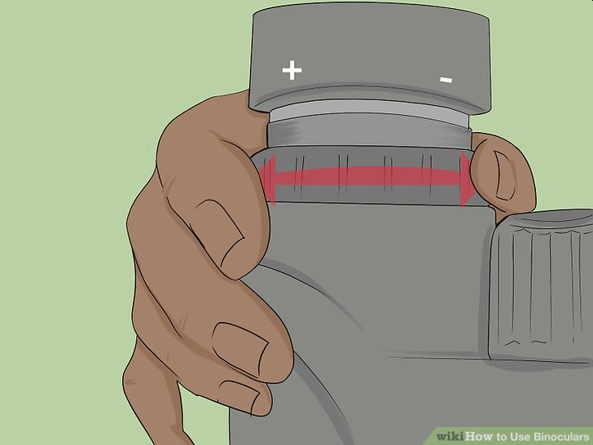
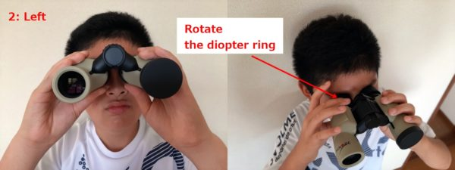
3b How to Use Binoculars
Focus your right eye with the diopter adjustment ring.
  Looking at the same object, put the cap on the left objective lens so that you can only see an image with your right eye.
  Then, rotate the diopter ring on the right eyepiece until you get a sharp image.
  Don't adjust the center focus wheel while adjusting the diopter.
Remove the cap so you can see the object with both eyes.
If you can comfortably get a sharp, crisp image, the binoculars are ready to use.
If there is a scale on the diopter ring, remember your number.
Even if someone else uses your binoculars, you can reset the diopter ring quickly.

Slide 29
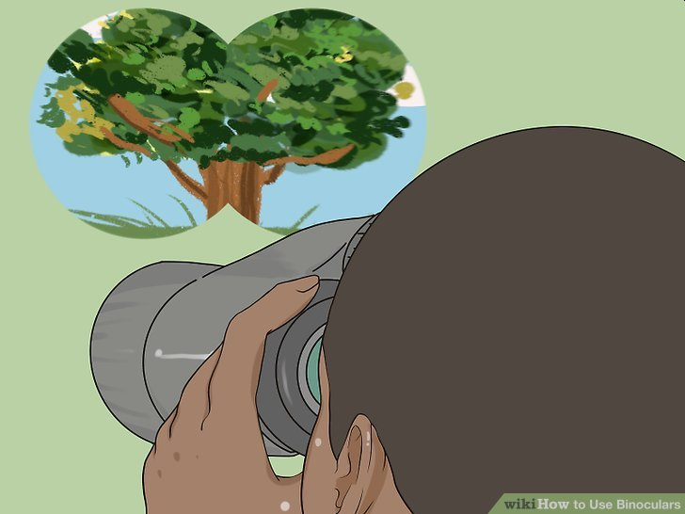
3b How to Use Binoculars
Look through both lenses at the same time to test the clarity.
After adjusting the central focus wheel and diopter gauge, the image should now be clearly focused in both eyes.
If you're still noticing some blurriness, repeat the process—adjusting the central focus wheel followed by the diopter—until the image is crystal clear.
The final view through your binoculars should seem three-dimensional.
If you feel a strain in your eyes, the binoculars might be out of alignment.
Contact your manufacturer if adjustments don't make a difference.

Slide 30
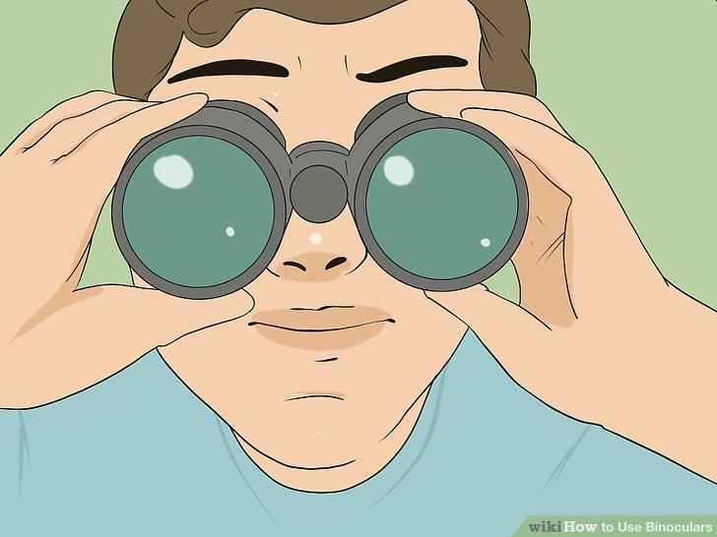
3b How to Use Binoculars
Practice aiming your binoculars on distant objects and locations.
The biggest challenge with binoculars, especially if you're watching small animals like birds, is aiming them properly.
Take a walk and look for distant objects to practice on, such as bright leaves on distant trees or a broken window on a building.
Start by locking your eyes onto to the object and then—without looking away—bring up your binoculars.
Keep doing this until you have no problem aiming your binoculars right at the object in question.
As you get better, practice on moving animals, such as squirrels, rabbits, and birds.
When you lock your eyes onto a distant animal, take note of features or landmarks around them and use them as points of reference when you look through your binoculars.

Slide 31
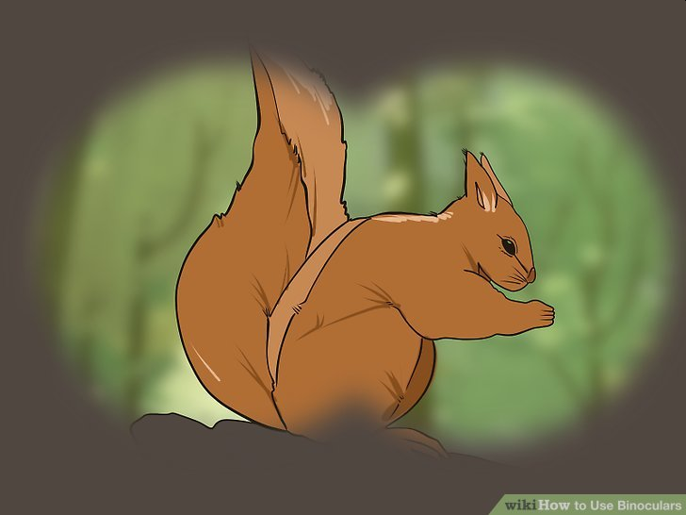
3b How to Use Binoculars
Target birds and animals without your binoculars.
Many beginners make the mistake of raising their binoculars right to their eyes after spotting an animal—don't do this!
Always look for animal movement with your naked eyes and lock onto them for a few seconds to give you a complete field of vision.
Only after following the target for a few seconds should you raise your binoculars to your eyes.
Scan around any bird you spot for other birds in its company.
Try looking back and forward along its flight path for the best odds.

Slide 32
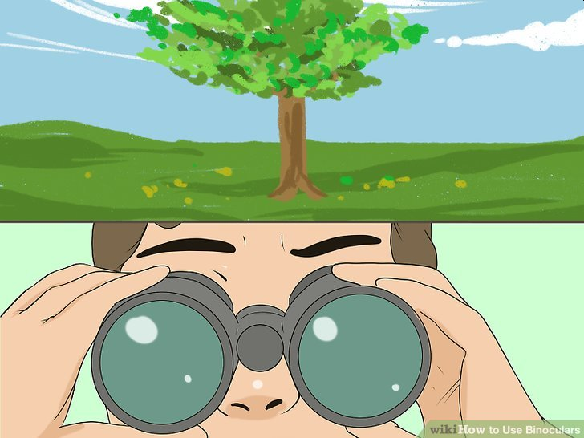
3b How to Use Binoculars
Scan open areas with your binoculars occasionally.
When you reach an open region—such as a large field—and have yet to locate or target a specific animal, occasionally scanning with your binoculars is beneficial.
Focus on edges, such as tree lines, fences, mudflats, and hedgerows, as these are the best perching and resting spots for birds and animals.
If you're scouting for birds, you can also scan the sky.
To do this, start by focusing on a distant treetop and then moving right or left across the horizon.
Don't scan the sky directly overhead—birds are more likely to disperse across a wide area.
Focus on clouds to help birds become more obvious against the background.

Slide 33
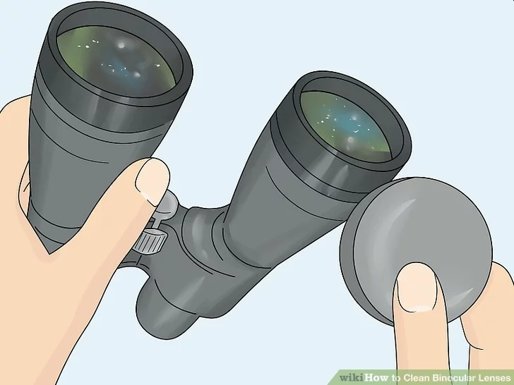
3c How to Care for Binoculars
Remove the lens caps and tilt the binoculars at an angle.
Pop the protective lens caps off of the ocular lenses, which are the lenses closest to your eyes.
You'll also need to take the caps off of the objective lenses, which are the larger lenses.
Then, pick up the binoculars and tilt the eyepiece end to a 130-degree angle.
Although you might be tempted to blow on the lenses to remove dust, the moisture from your breath will actually cause the dirt particles to stick to the lenses.
Tilting the binoculars as you work prevents the dust and dirt from falling back onto the lenses.

Slide 34
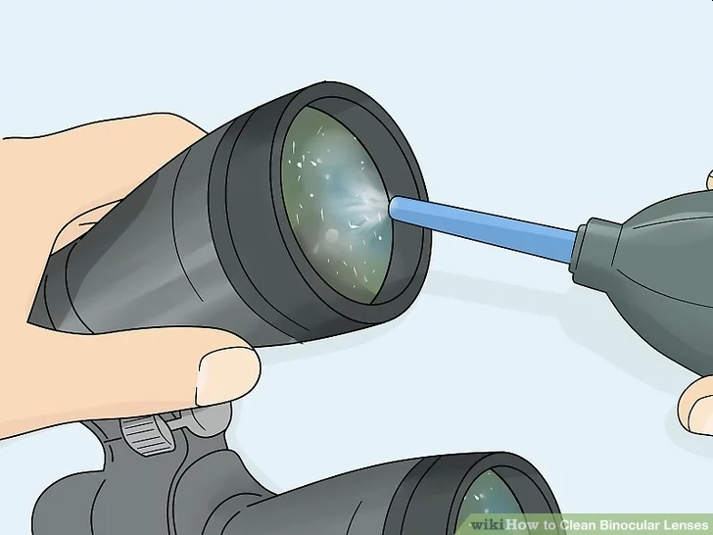
3c How to Care for Binoculars
Use an air blower pump to blow dust from the lenses.
With the binoculars tilted in 1 hand, squeeze a rubber air blower pump on the larger objective lenses.
Keep squeezing and blowing on both of these lenses so any dust or dirt particles fall onto your work surface.
Then, turn the binoculars so the small ocular lenses are tilting down and use the pump on them.
You can buy an air blower pump and other binocular cleaning supplies from photography supply stores, some outdoor supply stores, or online.

Slide 35
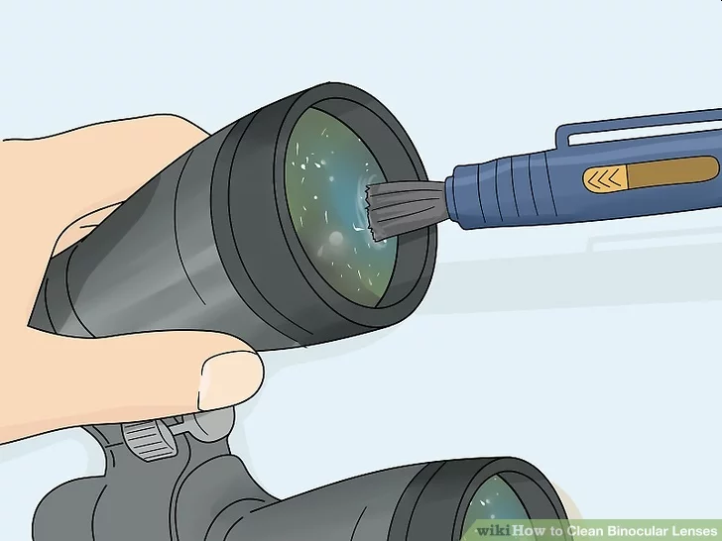
3c How to Care for Binoculars
Wipe the bristles of a lens cleaning pen over the surface of each lens.
Your lenses may still have stubborn dirt or debris stuck on the surface even after you used the air blower pump.
Since you need to remove this surface grime before wiping the lenses, take out a lens cleaning pen and wipe the soft bristle brush end over the entire surface of the lenses.
The bristles of the lens cleaning pen are designed to be gentle on the most delicate lenses so they won't scratch your binoculars.

Slide 36
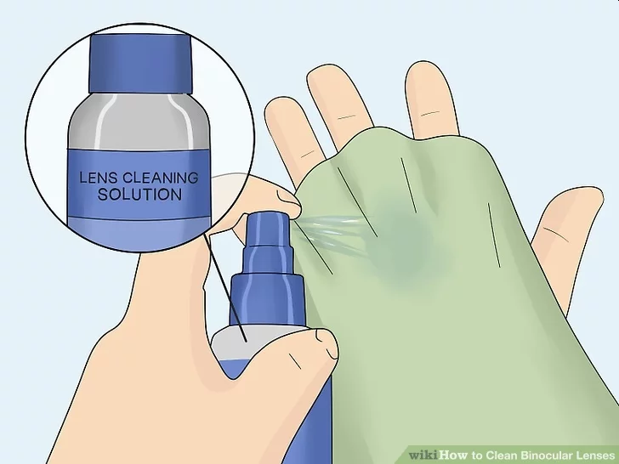
3c How to Care for Binoculars
Spray a microfiber cloth with lens cleaning solution.
Get out a clean microfiber cloth and remove the cap from your lens cleaning solution.
Spritz the middle of the microfiber cloth just once or twice so it's barely moist.
It's important to use designated lens cleaning solution instead of window cleaners.
Household cleaning products can strip the protective coatings from your binocular lenses.

Slide 37
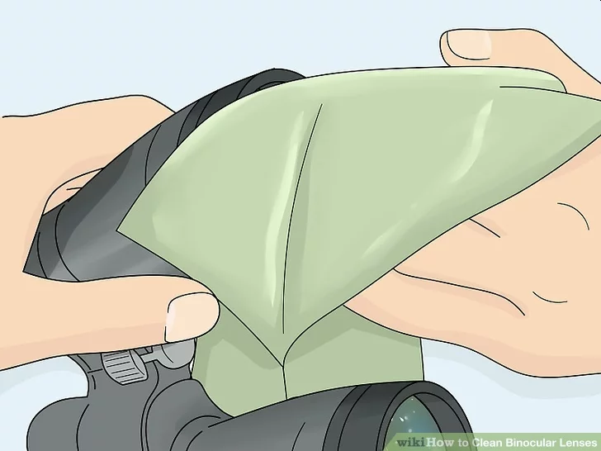
3c How to Care for Binoculars
Wipe the cloth over the surface of each lens to remove smudges or water spots.
Since there shouldn't be any dirt particles on the lenses, you won't scratch the lenses when you rub them now.
Take the moistened center of your microfiber cloth and gently rub it over each lens in a circular motion.
Rub just until you no longer see smudges or spots.
Your binocular lenses are now clean and ready to use!
If you don't plan on using them right away, remember to put the protective caps back on the lenses.

Slide 38
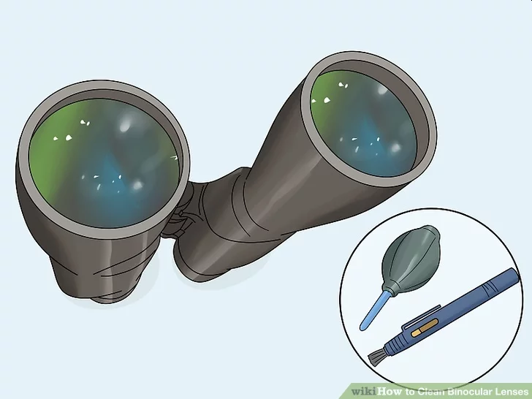
3c How to Care for Binoculars
Clean the lenses only when you see dirt, dust, or smudges.
You can clean the lenses too much which can damage their special coatings.
You're also more likely to scratch the lenses the more often you clean them.
Wait to clean the lenses until you see dust, pollen, smudges, or sand, for instance.
Your lenses will last longer with proper cleaning especially if you're not cleaning them several times a week.

Slide 39
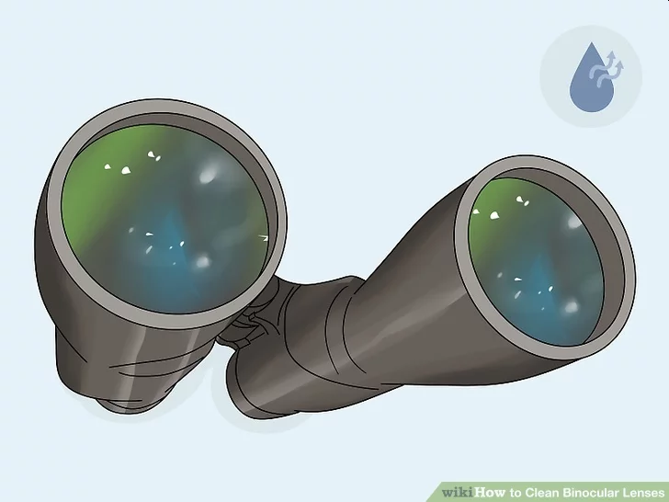
3c How to Care for Binoculars
Keep the lenses completely dry to prevent moisture buildup inside the binoculars.
You might have seen people hold their lenses under running water to clean them.
Unfortunately, water can become trapped inside the binoculars where it could grow mold.
Always keep your binoculars dry, even if they say they're waterproof.
If your binoculars do get exposed to moisture, leave the caps off of the lenses and let them dry out completely before storing them.

Slide 40
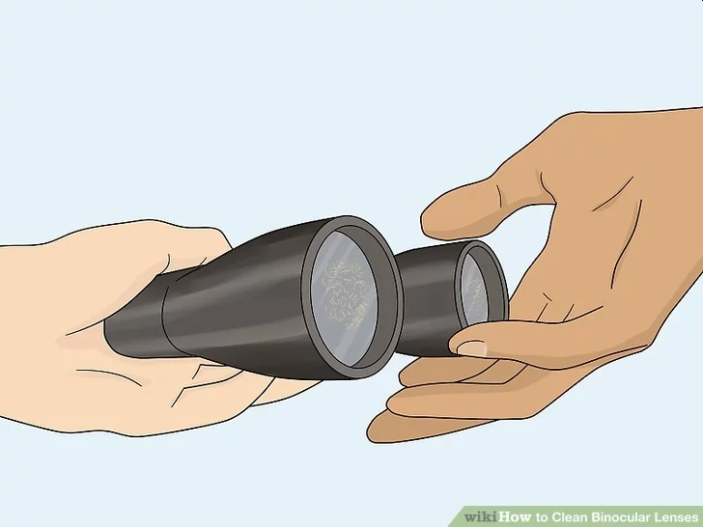
3c How to Care for Binoculars
Take the binoculars for professional cleaning if you see fungus growing on the lenses.
If your binoculars don't have good seals, moisture can become trapped inside them and with the right conditions, mold can grow.
Instead of trying to take apart your binoculars, take them to a professional that cleans binoculars.
You could also ask photography supply stores if they clean binoculars.

Slide 41
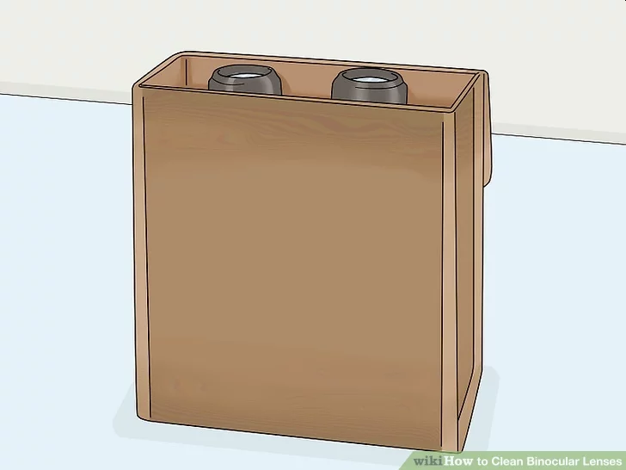
3c How to Care for Binoculars
Store your binoculars in their case when you're not using them.
The case is designed exactly for your binoculars and it protects the lenses from dust and dirt.
If you don't have a case, place the binoculars flat on a clean surface.
Don't stand them up on the larger lenses because dirt and debris will fall directly onto the small ocular lenses.
For short term storage, you could lay the binoculars flat and place a clean cloth over them to protect the lenses from dust.

Slide 42
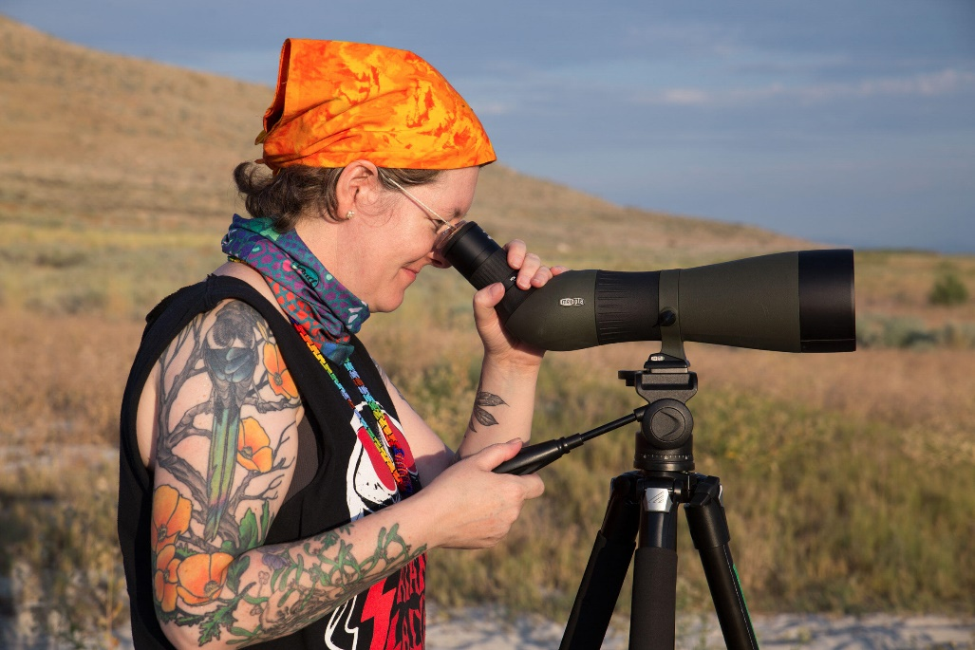
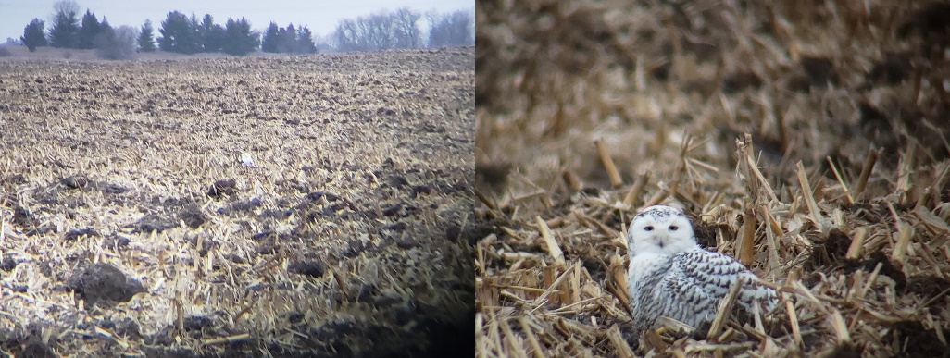
Requirement 3d
Spotting Scopes
For birds that are too far away even for binoculars, birders often use spotting scopes—essentially low-power telescopes mounted on tripods or wooden gunstocks.
Most scopes have zoom eyepieces ranging from 15 to 60 power, although the high magnifications are usually too dark and fuzzy to be of much use.
Scopes are generally much more expensive than binoculars, but there are times when you may need a scope to identify a distant bird.
Scopes should be used with a sturdy, lightweight tripod.

Slide 43
Requirement 4
Demonstrate that you know how to use a bird field guide. Show your counselor that you are able to understand a range map by locating in the book and pointing out the wintering range, the breeding range, and/or the year-round range of one species of each of the following types of birds:
  Seabird
  Plover
  Falcon or hawk
  Warbler or vireo
  Heron or egret
  Sparrow

Slide 44
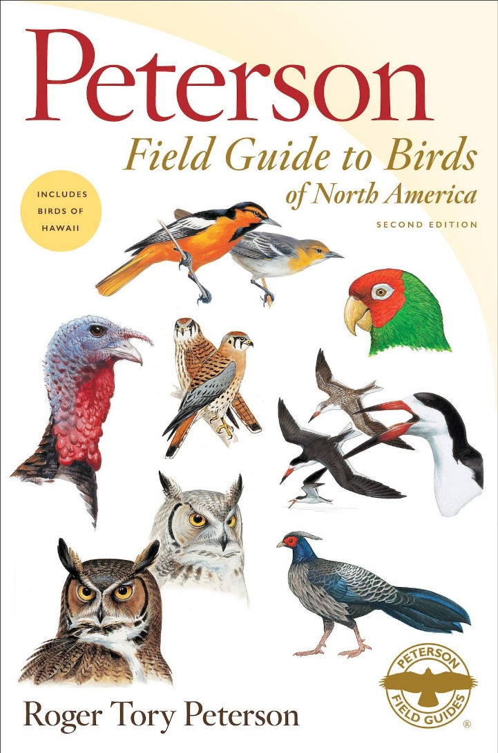
How to Use a Field Guide
Click on the following hyperlink: How to Use a Field Guide or download the PDF copy included with this presentation.

Slide 45

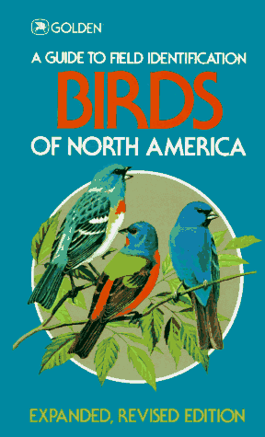
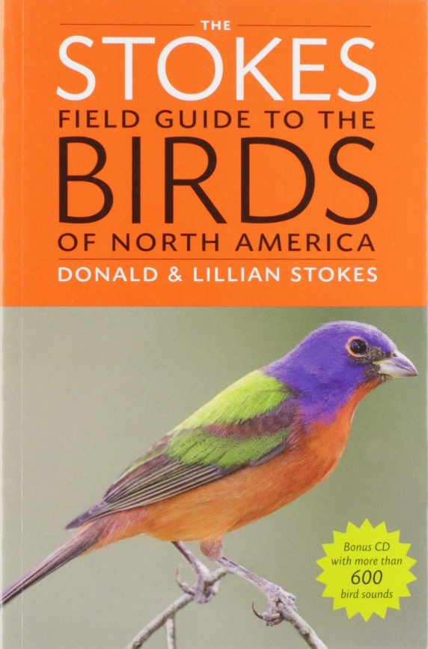
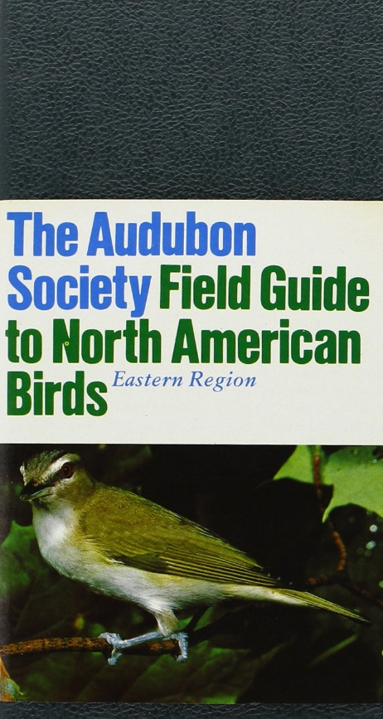
Bird Field Guides
Obtain a bird field guide from your library or purchase your own copy.
Examples of some common Bird Field Guides.

Slide 46
Requirement 5
Observe and be able to identify at least 20 species of wild birds. Prepare a field notebook, making a separate entry for each species, and record the following information from your field observations and other references.
  Note the date and time.
  Note the location and habitat.
  Describe the bird's main feeding habitat and list two types of food that the bird is likely to eat.
  Note whether the bird is a migrant or a summer, winter, or year-round resident of your area.

Slide 47
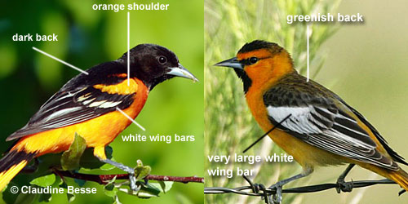
How to Identify Birds
When you see a new bird, you will be tempted to grab your field guide immediately and start paging through it, trying to find a picture that matches what you see.
Don’t. The best thing to do is study the bird a while, carefully looking for field marks.
Field marks are the distinctive stripes, spots, patterns, colors, and highlights that birds have in such abundance and variety.
Birds developed these patterns for many reasons, but one way they use some of these markings is to recognize members of their own species and bird watchers can use them for the same purpose.

Slide 48
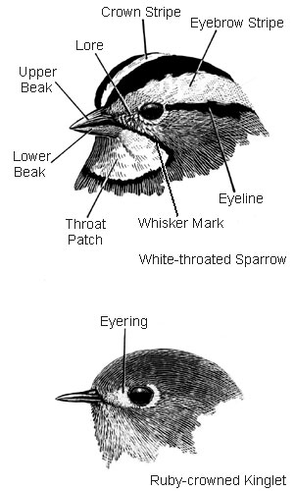
Field Marks of the Head
You’ve probably already taken a close look at your mystery bird’s head by now, if only to note its beak shape as a clue to its group.
Make it a habit to note these useful field marks as well (listed clockwise starting from the eyebrow stripe):
  Eyebrow stripe (or superciliary, line over the eye)
  Eyeline (line through the eye)
  Whisker mark (also called mustache or malar stripe)
  Throat patch
  Color of upper and lower beak
  Color of the lore (area between base of beak and eye)
  Crown stripe (stripe in the midline of the head)
  Eyering (ring of color around eye)
  Presence or absence of crest
  The color of the eye itself (iris) can also be very useful

Slide 49
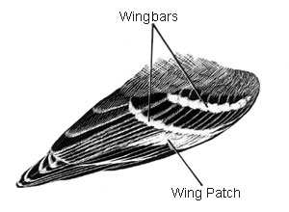
Field Marks of the Wing
Birds’ wings are another great place to pick up clues to a bird’s identity.
In a few groups, including warblers and vireos, wing markings can give you a positive identification even if the bird has molted out of its colorful breeding plumage.
In other groups, such as flycatchers and sparrows, the absence of wing markings may be important.
Ducks, shorebirds, raptors, among others, often show distinctive markings in flight, when their wings are spread and new feathers are exposed.
Keep an eye out for these wing field marks:
  Wingbars (stripes across the folded wing)
  Wing patches (blocks of color on the wing)
  Wing lining (the feathers covering the underside of the wing)
  Primaries (the long flight feathers on the outer half of the wing)
  Secondaries (the flight feathers on the inner half of the wing)
  Speculum (the patch of colored secondaries that helps identify many ducks)
  Wing tips

Slide 50
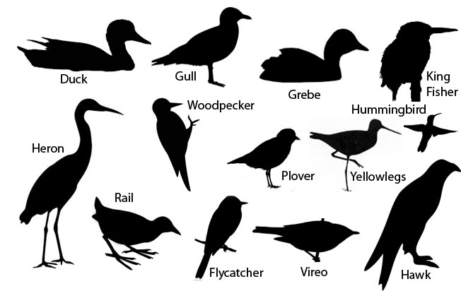
Bird Shapes
One of the most important clues for bird identification is the overall shape of a bird’s body.
A wood thrush and a brown thrasher, for instance, are colored much the same—rusty brown on top, with a white breast spotted in black.
  But the thrush is plump, with a fairly short tail and a short beak.
  The thrasher is slender and slinky, with a long tail and a long, pointed beak.

Slide 51
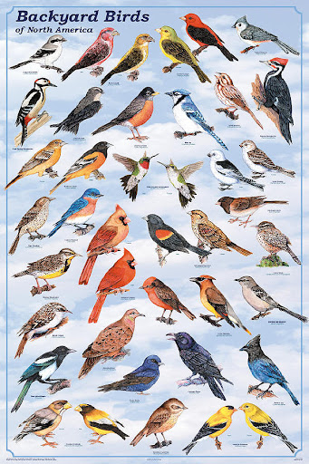
Colors and Patterns
Colors can be an important clue to a bird’s identity.
Hummingbirds have brilliant, metallic colors, but only if the sun hits them just right; otherwise, they can look black.
The same can happen with many dark blue birds, such as indigo buntings.
You should also remember that as a bird’s feathers get old and worn through the year, they often become less colorful.
Do not expect every bird you find to exactly match its picture in your field guide.

Slide 52

Field Notebook
The field notebook can be used as a bird identification learning tool.
Many of the birds that you see will not allow close approach or perch cooperatively in the open so that you can observe them easily.
Frequently, you will have to make identifications quickly, based on fleeting or distant views.
Keeping a field notebook will help you to make systematic, detailed observations of birds in the field.
The mere act of writing your observations down will help you to memorize important field marks, and the notebook will provide you with a quick reference for common species.
The discipline of keeping careful field notes is a basic skill for all biologists which will serve you well in the future.

Slide 53

Field Notebook
You can record your notes into any size or style of notebook that you wish.
You should record notes directly into your notebook while you are in the field.
You should record notes either in pencil or permanent ink.
Sketches greatly improve field notes.
  It is usually faster and easier to describe a bird by drawing it than by describing it in words.
  Simple drawings by connecting two ovals, one for the head and the other for the body can be used to place field marks (e.g. wing bars, eye ring).
Organize your notebook into three categories each time you go into the field: a daily journal, a species list, and identification notes for individual species.

Slide 54

Field Notebook
Daily Journal
For each trip into the field, you should make a separate entry.
Include the following:
  Date and time of day
  Name of the place visited
  Weather conditions
  Major habitats
  Who was with you.

Slide 55

Field Notebook
Species List
The species list section is a list of each of the species that you see on each trip noting your location and time.
You can use either common names or scientific names and abbreviations are acceptable as long as they are clearly defined within the notebook.

Slide 56

Field Notebook
Identification Notes
Your identification notes contain information on natural history, habitat, behavior, field markings, and sketches.
Describe anything distinctive about behavior.
  For example, note where and how the bird forages, whether it flicks its tail, what sounds the bird makes, etc.

Slide 57

Requirement 6
Describe to your counselor how certain orders of birds are uniquely adapted to a specific habitat. In your description, include characteristics such as the size and shape of the following:
  Beak
  Body
  Leg and foot
  Feathers/plumage

Slide 58

Bird Beak Adaptations
Varieties of beak shapes and sizes are an adaptation for the different types of foods that birds eat.
In general, thick, strong conical beaks are great at breaking tough seeds, and are found on seed-eating birds such as cardinals, finches, and sparrows.
Hooked beaks, such as those found on raptors like hawks, eagles, falcons, and owls, are adept at tearing meat – perfect for these predatory birds.
Straight beaks of intermediate length are particularly versatile and are often found on omnivorous birds like crows, ravens, jays, nutcrackers, and magpies.
There are even highly specialized bills such as the flamingo’s: their beaks are comma-shaped for filter-feeding, enabling them to sift through mud and silt in order to devour krill and other crustaceans.

Slide 59


Bird Body Adaptations
The bodies of birds are adapted for flying.
Many of a bird's bones are less dense than human bones, which makes birds' bodies lightweight.
Flying birds have large chest muscles that move the wings.
Birds have feathers that help them fly. The long flight feathers on the wings and tail help birds balance and steer.
Birds have a system of air sacs in their body that connect to the lungs.
  The air sacs enable birds to extract much more oxygen from each breath of air than other animals can.
  Birds need extra oxygen to release large amounts of energy to power their flight.
  Their four-chambered heart also helps a bird get more oxygen.
  The advantage of a four-chambered heart is that there is no mixing of oxygen-rich and oxygen-poor blood.
  Blood that arrives in the bird's body tissues has plenty of oxygen.
In order to fly, birds must have very quick reactions. When approaching a tree or cliff, a bird has only a few seconds to spot a place to land safely and avoid crashing.
Most birds have keener eyesight than humans do. Birds' eyes are much larger in relation to their body size than humans' eyes.

Slide 60

Bird Feet Adaptations
The feet of birds have evolved as an adaptation to the landscapes they inhabit.
Wading birds, such as egrets and herons, have long toes to help with weight distribution as they make their way over reeds and lily pads.
Ducks and pelicans have webbed feet which make them more adept swimmers.
Perching birds, like most songbirds, have a foot structure that allows them to grasp branches.
  The configuration of one toe at the back of the foot acts like a pincher, stabilizing the perched bird.
Nail structure plays an additional role in foot adaptation.
  The acute, strong nails of woodpeckers and flickers gives these species the ability to stand on and climb the vertical trunks of trees, a useful adaptation for reaching insects that burrow beneath the bark.
  The grasping, sharp claws of a raptor, on the other hand, are honed for subduing and even killing prey.
  Most running birds, such as ostriches and emus, do not perch, therefore their back claw is either reduced or entirely absent.

Slide 61


Bird Feather Adaptations
Birds have feathers that help them fly.
The long flight feathers on the wings and tail help birds balance and steer.
The specialized flight feathers of owls are fringed for silent flight, making owls nearly impossible to detect as they swoop down upon prey.
Plumage, or a bird’s feather pattern, is also shaped by natural selection for mating and survival.
  Plumage that is attractive to the opposite sex allows for more mating opportunities and, thus, the ability to create more young.
  Additionally, feathers can disguise an organism, creating camouflage for those that wish to hide from predators, or to sneak up on prey.

Slide 62

Requirement 7
Explain the function of a bird's song. Be able to identify five of the 20 species in your field notebook by song or call alone. Explain the difference between songs and calls. For each of these five species, enter a description of the song or call, and note the behavior of the bird making the sound. Note why you think the bird was making the call or song that you heard.

Slide 63

Birdsongs and Bird Calls
It’s often said that good birders actually see only a small percentage of the birds they identify.
The rest, they recognize from songs and calls.
Start by learning a dozen or two of the most common birdsongs in your area by listening to a Bird Song CD and by keeping your eyes and ears open when you are outside.
A Field Guide to Bird Songs includes the songs and calls of 267 species - all the most common and vocal birds found east of the Rockies. Organized as a companion to Roger Tory Peterson's Field Guide to the Birds of Eastern and Central North America, fifth edition.

Slide 64

Birdsongs and Bird Calls
Songs Versus Calls
Most birds have a wide repertoire of songs and call, but there’s an important distinction to be made between the two.
Among the songbirds and various other groups of birds (such as cuckoos, owls, and nightjars), songs are used to defend territory and attract mates.
  Therefore, it’s the males that sing the most—usually during breeding season.
Turn on your computer speakers and click on the following hyperlink: A Beginner’s Guide to Common Bird Sounds and What They Mean, to experience the world of bird sounds.

Slide 65


Types of Calls
Alarm calls
  Birds can tailor their calls to respond to a wide range of threats.
  If a raptor’s flying overhead, a songbird may make a short, quiet, high-pitched sound that won’t carry far.
  This alerts nearby birds without revealing the caller’s location.
  But if a raptor is perched, smaller species might try to project deeply and loudly to rally the troops and mob the intruder.

Slide 66

Types of Calls
Contact calls
  Birds make contact calls to keep in touch with each other, often while they’re foraging for food.
  These sounds are usually short, quick, and quiet, though if birds get separated, they may make louder, more urgent “separation calls.”

Slide 67

Types of Calls
Flight calls
  Species that flock often call back and forth while in flight; this is a good way to detect clouds of blackbirds, waxwings, siskins, or bluebirds passing overhead.
  Flocks of shorebirds also may be vocal in the air.
  But many less-social species also have distinctive flight calls that are quite different from their usual calls.
  During spring and fall, most songbirds migrate at night; if you listen closely, you can hear their various chirps drifting down from the dark sky.

Slide 68

Types of Calls
Begging calls
  Youngsters make “feed me” noises, often while simultaneously fluttering their wings to get their parents’ attention.
  These calls may be regularly repeated and sound pathetic.
  They're also not the best for getting down to species IDs, but they'll tip you off to any parent-chick viewing opportunities.

Slide 69
Requirement 8
Do ONE of the following:
  Go on a field trip with a local club or with others who are knowledgeable about birds in your area.
    Keep a list or fill out a checklist of all the birds your group observed during the field trip.
    Tell your counselor which birds your group saw and why some species were common and some were present in small numbers.
    Tell your counselor what makes the area you visited good for finding birds.
  By using a public library, the Internet, or contacting the National Audubon Society, find the name and location of the Christmas Bird Count nearest your home and obtain the results of a recent count.
    Explain what kinds of information are collected during the annual event.
    Tell your counselor which species are most common, and explain why these birds are abundant.
    Tell your counselor which species are uncommon, and explain why these were present in small numbers. If the number of birds of these species is decreasing, explain why, and what, if anything, could be done to reverse their decline.
  Participate in a bird banding program with an approved federal or state agency, university researcher, bird observatory, or certified private individual.
    Explain who is able to band birds and why.
    Explain why birds get banded.
    Explain what kinds of birds get banded.
    Tell how the birds were captured, the number of bird species recorded during your visit, and your role in the program.

Slide 70

8a Finding a Bird Club Near You
Click on the following hyperlink to use the Bird Watchers Digest Bird Club Finder for an organization near you.

Slide 71

8b Christmas Bird Count
Click on the following hyperlink to visit Audubon Society Christmas Bird Count website.
Click on the tab “Access Count Results”.
Follow the instructions on the webpage for accessing your State’s information.

Slide 72

Requirement 9
Do ONE of the following. For the option you choose, describe what birds you hope to attract, and why.
  Build a bird feeder and put it in an appropriate place in your yard or another location.
  Build a birdbath and put it in an appropriate place.
  Build a backyard sanctuary for birds by planting trees and shrubs for food and cover.
  Build a nest box for a species of your choice using plans approved by your counselor.

Slide 73

9a Build a Bird Feeder
Click on the following hyperlink to Build a Bird Feeder from Recycled Materials or download the PDF file included with this presentation.

Slide 74
9b Build a Birdbath
Click on the following hyperlink to Build a Birdbath or download the PDF file included with this presentation.

Slide 75

9c Build a Backyard Bird Sanctuary
Research birds in your area. Find out what types of birds live in your area or are likely to come to your property through migration. You may want to obtain a field guide to the area in order to know which birds to attract. Aim to create an environment that can support many different species. Bear in mind that you can attract different species depending on the season, as well.

Slide 76

9c Build a Backyard Bird Sanctuary
Choose a bird feeder. The type of feeder you choose will influence what bird species you attract. No matter what, your bird feeder should have a few essential qualities: it should be difficult for squirrels to access, it should keep food dry, and it should be easy to clean. Bird feeders need to be washed out regularly so the food inside remains free of fungi and disease. The most common types of feeders include: Tray feeders. Tray feeders are simple, flat trays that allow birds very easy access to seed. The downside is that seed is also accessible to squirrels and unprotected from the weather.
House feeders. These keep the seed in a contained area and dispense it as the birds feed on a small tray at the bottom of the feeder.
Window feeders. Window feeders attach to your window with suction cups, offering a full view of bird activity. They will attract birds like chickadees, finches, and some kinds of sparrows.
Suet feeders. Suet feeders are designed to offer suet cakes, which attract different birds like woodpeckers, nuthatches, and chickadees.
Tube feeders. To attract hummingbirds, use a tube feeder. These dispense sugar water through a tube.

Slide 77

9c Build a Backyard Bird Sanctuary
Provide seed and other food. Birds will be attracted to your yard if you offer them food. However, there are certain things to keep in mind. Do you know what species you are hoping to attract? If you would like to invite a wide range of native species, it's a good idea to have more than one type of feeder and to offer a variety of food. You will inevitably bring less desirable birds – common sparrow, pigeon, or crow – but with good seed choice you can maximize your target birds. Corn is a favorite among nearly all birds but is to be used sparingly -- it will attract all sorts of animals. It is also important to be careful about the source of the corn since cheap corn can be contaminated with pesticides that are toxic to birds.
Sunflower seeds are popular among all seed-eating birds, which makes them a good choice if you want a variety of species. However, the shells must be raked up frequently. Sunflower seeds will also tempt squirrels.
White proso millet is a tasty treat for cardinals, quail, sparrows, doves, and crows. It is also attractive to house sparrows and other animals. Hummingbirds love to drink sugar water, meanwhile, and safflower seeds are good for attracting cardinals, chickadees, doves, sparrows, and grosbeaks.
Suet, the fat around cow and sheep organs, attracts woodpeckers, nuthatches, wrens, jays, and starlings. Peanut butter makes a good winter food since it is highly nutritious. Just make sure that it doesn't contain additives.

Slide 78

9c Build a Backyard Bird Sanctuary
Know what foods to avoid. Birds can easily be poisoned by food that is contaminated or contains hard-to-digest ingredients. Be sure to buy high-quality seed or suet. Some cheap manufacturers of bird food cut corners, so consider springing for a more expensive brand. Here are a few foods to avoid putting out:
Bread, crackers, or other processed carbohydrates do not offer birds much nutritional value and can have toxic ingredients. Bacon drippings or other meats can meanwhile contain harmful nitrates. Both may end up attracting mice and rats instead.
Cheap feeds often contain “filler seeds” that are not eaten like red millet, golden millet, oats, and flax. Be sure to check the ingredients in the purchased feed.

Slide 79

9c Build a Backyard Bird Sanctuary
Install the feeder in a safe location. If you want the feeder to be near enough for you to view it from your house, place it within 3 ft (0.91 m) of your window. If you want to give the birds more space, place the feeder about 30 ft (9.1 m) from your home. The feeder should also be far enough away from tree cover to prevent squirrels from reaching the feeder from a tree.
Also, keep the blinds in your home at least halfway closed during the day so the birds will be less likely to fly through the window.

Slide 80

9c Build a Backyard Bird Sanctuary
Maintain the feeder. It is important to change the food frequently and clean the feeder with soap and water every few weeks. Otherwise, bird droppings, fungus, and bacteria can contaminate the feeder and the food, potentially sickening birds. Be particularly vigilant during wet weather, when damp food is more susceptible to mold. For the same reason, and because it attracts undesirable animals, food that has fallen to the ground should be cleared away.

Slide 81

9c Build a Backyard Bird Sanctuary
Provide grit. Birds lack teeth and many instead rely on an organ called a gizzard to digest food. To work properly the gizzard needs grit – bits of sand, gravel, or other small stones. You can help by offering insoluble grit (e.g. small pieces of gravel) or soluble grit (like cuttlebone, crushed oyster shell, or crushed eggshell). Eggshell serves a dual purpose by giving the birds calcium needed for egg-laying.

Slide 82

9c Build a Backyard Bird Sanctuary
Plant native trees, shrubs, and plants. Use a local field guide or call your local Audubon Society chapter (if you live in the United States) to find out what grows naturally in your region, and add these plants to your garden. Native trees, shrubs, and plants are more likely to attract birds than non-native trees, shrubs, and plants. A variety of native trees, shrubs, and grasses will also provide natural shelter and cover for birds.
Evergreen trees and shrubs like hollies make great homes for birds over the winter.
Many birds are attracted to fruit and berries, so consider planting an apple tree or planting a blueberry bush.

Slide 83

9c Build a Backyard Bird Sanctuary
Create a nesting site using natural materials. If you would like to create a more natural nesting spot, an easy way to do it is to allow your yard to grow a bit wilder. Let the grass grow in a certain spot or build a brush pile. This simulates the type of habitat where birds nest in the wild. You might alternately heap branches into a large pile or create sites under your bushes by raking mulch around the base.
Consider supply nesting material such as string, hair, or other fibers, or stuff mesh bags with pieces of yarn or string, straw, pet fur, small bits of cloth, or anything else that a bird might use to nest.
Don't remove dead trees unless they are a danger. Standing dead trees are important nesting and foraging spots for many species, especially woodpeckers, which eat the insects that infest dead trees.

Slide 84

9c Build a Backyard Bird Sanctuary
Provide a water source. Birds are attracted to the sound of dripping or moving water. You can buy a birdbath or create a shallow pond with a fountain. Make sure it is close to the ground and not made of slippery material. If you are short on time or resources, hang a water-filled container with a hole on the bottom above a dish. Try not to place the water source near trees or bushes where cats might hide. Also, make sure the water is not more than 1 inch (2.5cm) deep.
Consider using a heated water source during the winter. For the sake of sanitation, find a bath that is easy to clean. Ensure that the water does not become stagnant or harbor algae.[

Slide 85

9c Build a Backyard Bird Sanctuary
Avoid pesticides. Pesticides are harmful to birds in more ways than one. First, they kill vital sources of food for some species. Second, the chemicals in the pesticides can be dangerous for birds to ingest. In order to attract birds to your property, use natural forms of insect control instead of chemicals on your lawn, trees, and shrubs.

Slide 86

9c Build a Backyard Bird Sanctuary
Keep cats and other predators away. Cats, snakes, raccoons, and rats prey on songbirds or their eggs, killing millions every year. No matter how hospitable your yard may seem, having a cat prowling around will act as a disincentive. Keep your cat away from feeding, drinking, and nesting areas if you are seriously interested in attracting birds.
Hole restrictors, baffles, and tube entrances are good ways to secure birdhouses. Mounting the house well above ground and using predator repellent are two added safeguards.

Slide 87

9d Build a Nest Box
Build a birdhouse or nesting box. Different species nest in different places, so it is a good idea to conduct research on the type of bird you wish to attract. If you plan to buy a birdhouse or build a nesting box, take note that boxes with different holes, shapes, and orientations will attract different species. Such a box can be mounted to a tree or hung from a pole.
Make sure that the box is up no later than February if you are in a southerly location; if in the north, hang it in March.
Make sure that your nest site has adequate ventilation and is supplied with a "baffle" and reinforcement ring at the opening. This will prevent predators from entering.

Slide 88

9d Build a Nest Box
70birds
Birdhouse Plans for North American Birds
Click on the above link for birdhouse plans for 70 species of North American birds.

Slide 89

Requirement 10
Do the following:
  Explain the differences between extinct, endangered, and threatened.
  Identify a bird species that is on the endangered or threatened list. Explain what caused their decline. Discuss with your counselor what can be done to reverse this trend and what can be done to help remove the species from the endangered or threatened list.

Slide 90
Extinct, Endangered, Threatened
Extinction - is the complete disappearance of a species from Earth.
Endangered - any species that is in danger of extinction throughout all or a significant portion of its range.
Threatened - any species that is likely to become an endangered species within the foreseeable future throughout all or a significant portion of its range.

Slide 91

Examples of Extinct Birds

Slide 92





Examples of U.S. Endangered Birds
California Condor
Gunnison Sage Grouse
Whooping Crane
Golden-Cheeked Warbler
Kirkland’s Warbler

Slide 93
Cause of Decline
Golden-Cheeked Warbler
  Habitat destruction is destroying nesting grounds in Texas, deforestation in Central America is wiping out its wintering lands.
California Condor
  Suffered a serious drop in numbers due to hunting, habitat destruction, as well as poisoning from lead bullets (left behind in carcasses later scavenged) and pesticides.
Gunnison Sage Grouse
  Loss of habitat has been extremely detrimental for the animal, which requires a variety of land types for its survival, including sagebrush and wetlands.
Whooping Crane
  Habitat loss and hunting left only 15 whopping cranes alive in 1941, but with the help of biologists, their numbers rebounded to as many as 214 in 2005. However, due to a lack of adult birds, the animals needed to be taught how to migrate north to their breeding grounds.
Kirkland’s Warbler
  Its survival depends on the burning of its native jack pine forest for nesting, but when people began suppressing natural fires, the bird’s existence was placed in jeopardy. In 1971, only 201 pairs of the bird remained. Habitat preservation, mainly by planting jack pines, has since resulted in the population growing.

Slide 94





Examples of U.S. Threatened Birds
Bald Eagle
Great Egret
Peregrine Falcon
Piping Plover
Eastern Meadowlark

Slide 95
Cause of Decline
Bald Eagle
  Habitat destruction and degradation, illegal shooting, and the contamination of its food source, due to use of the pesticide DDT, decimated the eagle population. Habitat protection afforded by the Endangered Species Act, the federal government’s banning of DDT, and conservation actions taken by the American public helped Bald Eagles make a remarkable recovery.
Great Egret
  At the beginning of the twentieth century, great egret populations came close to extinction due to excessive market hunting. The species' feather plumes were in great demand for use in women's apparel. Although populations recovered somewhat after market hunting was outlawed and legal protection was established, the degradation and loss of wetland habitats and the development of coastal areas have prevented populations from returning to their previous levels. Disturbance to rookeries, either by predators or people, continues to hamper recovery efforts.
Peregrine Falcon
  They became endangered due to the use of harmful pesticides such as DDT. Pesticides, PCBs, and heavy metals continue to threaten their population.
Piping Plover
  These small shorebirds are primarily threatened by the development of the coastal beaches where they nest. They are incredibly sensitive to human presence and will abandon their nests if disturbed.
Eastern Meadowlark
  The reasons for decline include: urban development, changes in farming practices and the increasing prevalence of exotic grass species reducing areas where they can nest and thrive.

Slide 96

Requirement 11
Identify a nonnative bird (introduced to North America from a foreign country since 1800). Describe how nonnative birds may become damaging to the ecosystem

Slide 97

Nonnative Birds
European Starling
An admirer of Shakespeare released 60 European Starlings into Central Park in the 1890s in a misbegotten attempt to populate the American landscape with all birds celebrated by the bard.
Once established, these birds quickly spread.
It's estimated that Starlings cause more than $800 million in crop damage each year in the United States.
In addition, they often evict native birds from their nests, which has raised concerns about their impact on other species' reproductive rates.
They are also known to carry a variety of avian diseases (transmissible gastroenteritis, blastomycosis, and salmonella), and their droppings provide a growth medium for Histoplasma capsulatum, a fungus that causes lung infections in humans.

Slide 98

Nonnative Birds
Rock Pigeon
Rock Pigeons are native to Europe, North Africa, and parts of Asia.
They arrived in North America with English colonists in the early 17th century and soon began their own colonization efforts, eventually reaching all of the continental U.S., much of Canada, and even parts of southern Alaska.
Typically observed in cities or on farms, these birds thrive in human-altered landscapes.
Although there is little evidence that Rock Pigeons negatively impact native birds, they do carry a variety of parasites and pathogens, including avian influenza.

Slide 99

Nonnative Birds
House Sparrow
House Sparrows were introduced in Brooklyn in 1851 as a means of controlling caterpillar populations and, thus, protecting the city's basswood trees from Linden Moths.
After several subsequent releases, this Old World songbird made the entire continental U.S. its home in less than 50 years.
Some farmers consider House Sparrows pests, and they are fierce competitors for nesting space, driving native species from nest boxes.

Slide 100



Requirement 12
Identify three career opportunities connected to the study of birds. Pick one and find out the education, training, and experience required for this profession. Discuss with your counselor if this profession might interest you.

Slide 101
Careers in Ornithology
What Is an Ornithologist?
  An ornithologist studies birds, but there is no clear job description for the profession of ornithology.
  Many ornithologists do not work exclusively with birds.
    They may work as wildlife biologists, ecologists, land managers, teachers, researchers, environmental educators, legislative advocates, or eco-tour guides.
  While job duties vary by position, ornithologists may conduct field research to better understand migration routes, reproduction rates, and habitat needs; monitor and assess the status of a particular population; capture and band birds to track their movements and identities; analyze collected data; conduct wildlife impact assessments for development projects; and create management plans and reports.
  They may also serve as park rangers or work at nature reserves.
  Those employed by nonprofit conservation organizations may also be involved in policy development and advocacy.

Slide 102
Careers in Ornithology
What Do Ornithologists Do?
  While job duties vary by position, ornithologists may conduct field research to better understand migration routes, reproduction rates, and habitat needs; monitor and assess the status of a particular population; capture and band birds to track their movements and identities; analyze collected data; conduct wildlife impact assessments for development projects; and create management plans and reports.
  They may also serve as park rangers or work at nature reserves.
  Those employed by nonprofit conservation organizations may also be involved in policy development and advocacy.

Slide 103
Careers in Ornithology
Where Does an Ornithologist Work?
  Most ornithologists work for land and wildlife agencies at the federal and state levels, or nonprofit conservation organizations.
  They may also teach and conduct research at colleges and universities.
  Some work at zoos, wildlife parks, and as veterinarians and environmental scientists, though these jobs are rarely exclusive to birds.
  Workers in certain positions may spend a significant amount of time in the field gathering data and studying birds in their natural habitats.
  Fieldwork may involve travel to remote locations, including international travel.
  Ornithologists also work in laboratories, and may process data with computers in an office setting.
  Most ornithologists work full time although they may work non-standard or extended hours when doing fieldwork, such as during breeding season.

Slide 104
Careers in Ornithology
What Is a Typical Ornithologist's Salary?
  While the U.S. Bureau of Labor Statistics (BLS) doesn't have data specifically on ornithologists, they're included among zoologists and wildlife biologists.
  The median annual wage for these professions was $66,350 as of May 2020.
  Those in the federal government earned a median of $81,530, while ornithologists teaching at colleges, universities, and professional schools earned a median of $62,300.
  Those in state government made a median salary of $59,660.
What Is the Job Demand for Ornithologists?
  Employment of zoologists and wildlife biologists is projected to grow 5 percent between 2020 and 2030. Competition for jobs is strong.

Slide 105
Careers in Ornithology
Getting an Ornithology Degree
  Most ornithologists start out with bachelor's degrees in biology, wildlife biology, zoology, or ecology.
  A good background in science and math is essential.
  Knowledge of statistical software is also helpful, especially for advanced positions.
  Since ornithologists spend a good deal of time writing reports, good communication skills and courses on technical writing are also beneficial.
  However, while education is a must, practical experience in the field or lab is also critical. You can start gaining experience through local bird watching clubs, workshops, internships, and volunteer work for nonprofit wildlife and conservation organizations.
  Master's degrees are usually prerequisites for higher-level positions. Doctorates are required for most university and research positions.

